Slide 1
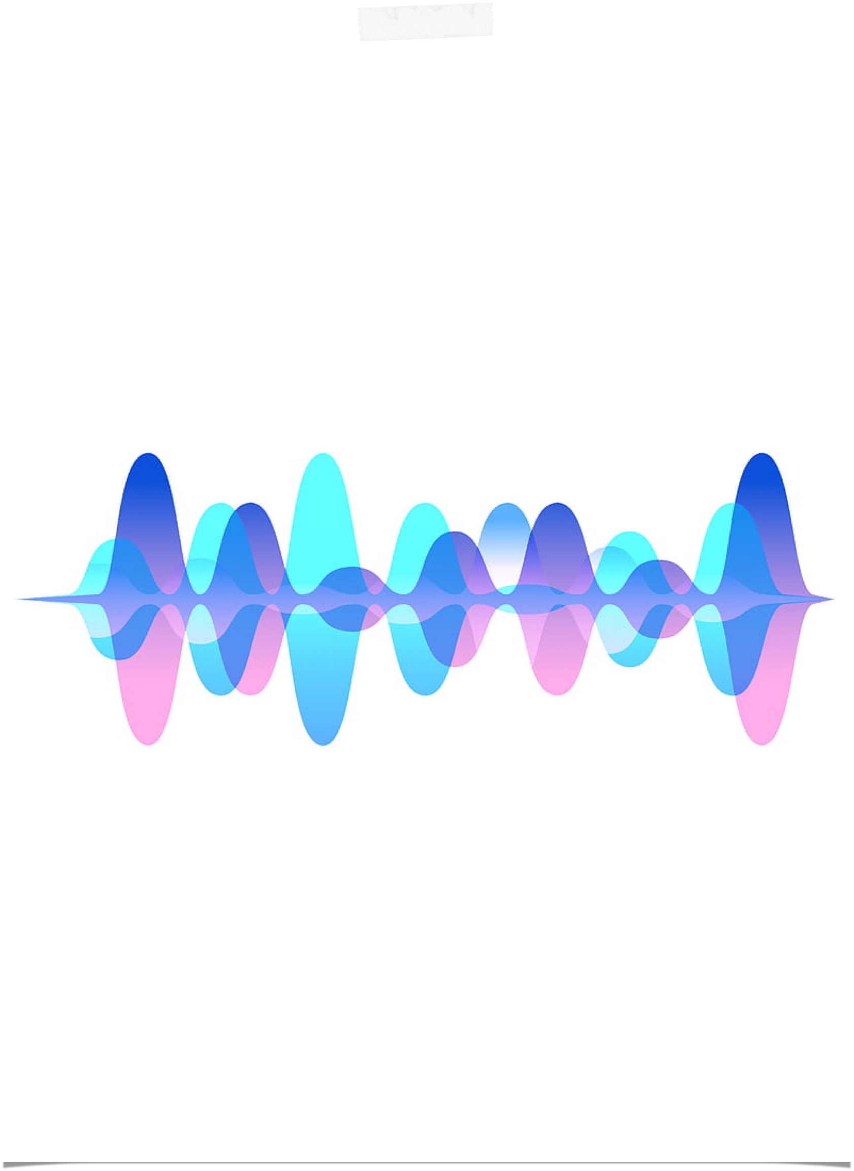






ZillionPitches
0
VOICE ANALYSIS
ZakaAi-MLC Program
6th of June 2022
Soulayman Al-Abdallah
Raed Diab
Project for: ZillionPitches Ai Solutions

Slide 2

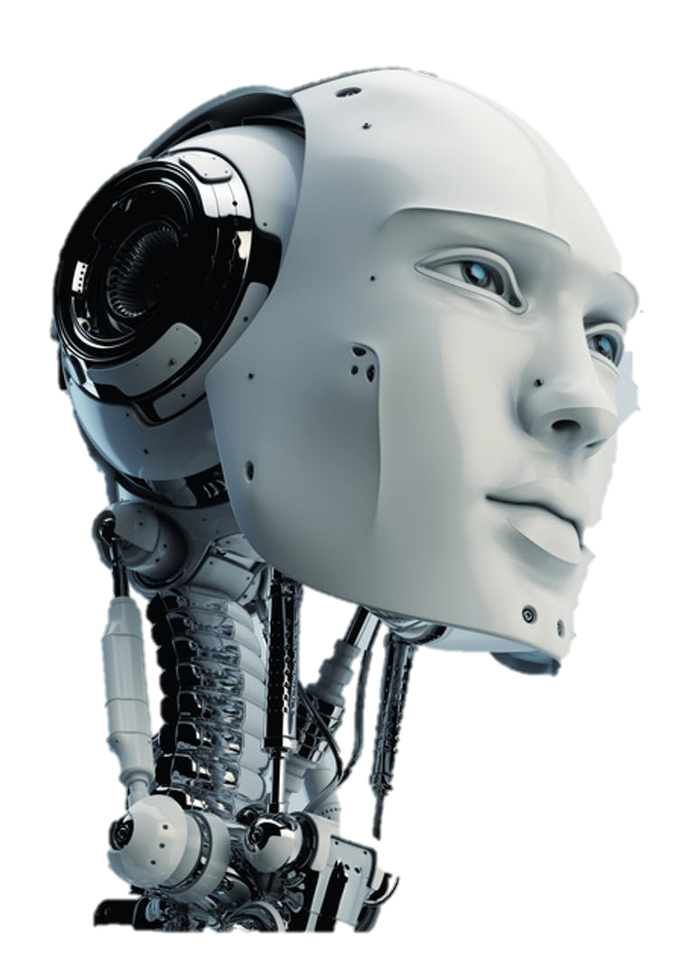
A significant percentage of business start-ups fail due to some weaknesses in their elevator pitch.
Some business founders come up with unique, scalable and sustainable ideas, that satisfy the needs of a target niche in the market, but some pitching deficiencies disturb the accurate understanding by the potential investors.
We are using AI to help founders detect and correct mistakes in their elevator’s pitching and content, by scoring some features through voice analysis.
In this way, they will be ready enough for pitching their ideas and succeed in getting the needed financial support.
Notes:
Introduction & motivation for the problem domain

Slide 3
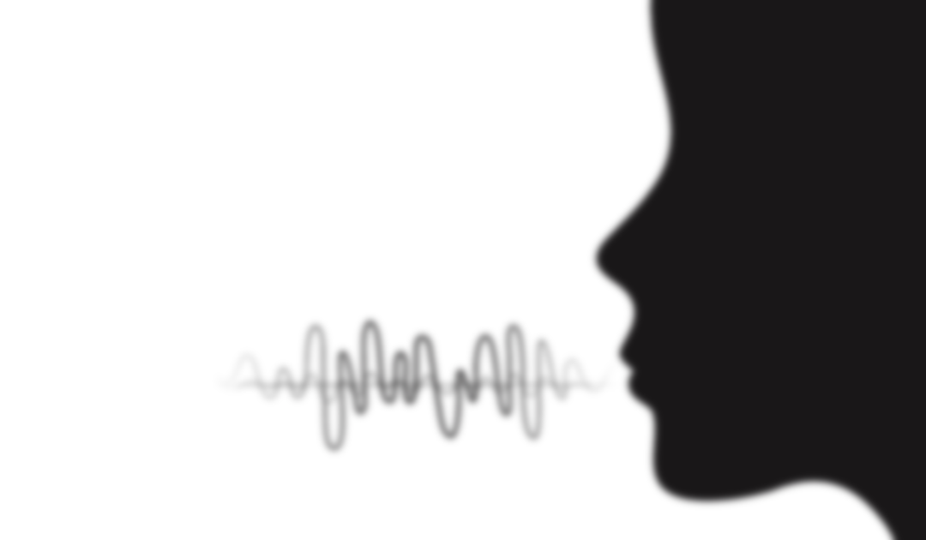

A significant percentage of business start-ups fail due to some weaknesses in their elevator pitch.
Technical Approach
Our machine learning model focuses on two relevant features extracted from the pitch: Language Fluency & Sound Emotions.
The business founder needs to upload his elevator pitch on Youtube, and provide our web Flask app with the video’s URL.
The video will be downloaded, the audio .wav copy will be generated, divided into windows of 5 seconds, each window will get the suitable classification by the model and then an overall classification of the whole audio file will be shown.
Insert URL
Audio Copy Created
5 sec Sub-audios creation
Pass each Sub-audio to the model
Notes:
Problem definition from a technical perspective
Show a figure representing the model(inputs, outputs)

Slide 4
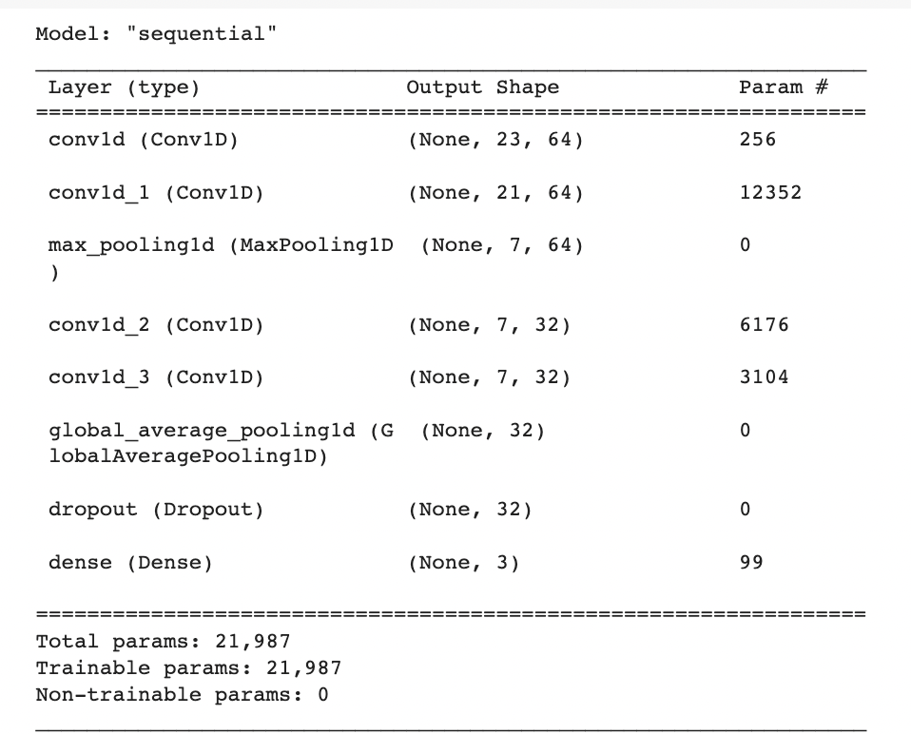
A significant percentage of business start-ups fail due to some weaknesses in their elevator pitch.
Now for each 5s audio window, we pass it in both fluency model and emotions model we used a neural network with conv1D, pooling, and dense layers in addition to some dropouts and batch normalizations.
Fluency model
Low Fluemcy
Intermediate Fluemcy
High Fluency
Fluency model
1D array of signal processing features by Librosa
At the end, regarding the whole audio, a percentage of each class, for both, the fluency and emotion classification model, will be featured on the interface.
Notes:
Now for each 5s audio window, we pass it in 2 feature_models: Fluency_Model and Emotions Model.
For both models, we used a neural network with conv1D, pooling, and dense layers in addition to some dropouts and batch normalizations.
The input of the models is a 1D array of values that represents numerous signal processing features by the Librosa library like: MFCCs, RMSE, Spectral Flux…
The output of the Fluency model is a classification of the audio’s language fluency among 3 possibilities: Low Fluency - Intermediate Fluency - High Fluency.
The output of the Emotions model is a classification of the audio’s emotions between 7 possibilities: sleepy, neutral, happy, angry, disgusted, fearful and surprised.
At the end, regarding the whole audio, a percentage of each class, for both, the fluency and emotion classification model, will be featured on the interface.

Slide 5
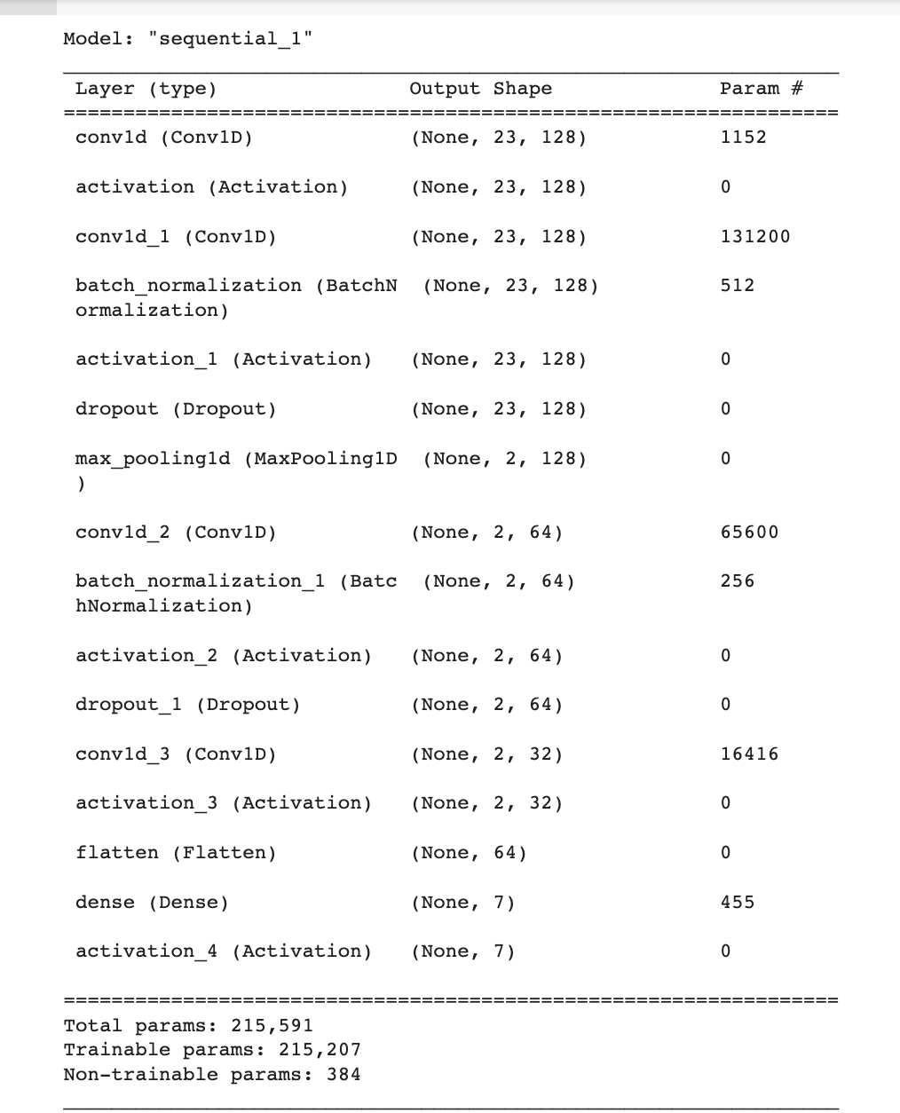
A significant percentage of business start-ups fail due to some weaknesses in their elevator pitch.
Now for each 5s audio window, we pass it in both fluency model and emotions model we used a neural network with conv1D, pooling, and dense layers in addition to some dropouts and batch normalizations.
Emotions Model
sleepy
neutral
happy
Emotions model
Fluency model
angry
1D array of signal processing features by Librosa
disgust
fear
surprised
At the end, regarding the whole audio, a percentage of each class, for both, the fluency and emotion classification model, will be featured on the interface.
Notes:
Now for each 5s audio window, we pass it in 2 feature_models: Fluency_Model and Emotions Model.
For both models, we used a neural network with conv1D, pooling, and dense layers in addition to some dropouts and batch normalizations.
The input of the models is a 1D array of values that represents numerous signal processing features by the Librosa library like: MFCCs, RMSE, Spectral Flux…
The output of the Fluency model is a classification of the audio’s language fluency among 3 possibilities: Low Fluency - Intermediate Fluency - High Fluency.
The output of the Emotions model is a classification of the audio’s emotions between 7 possibilities: sleepy, neutral, happy, angry, disgusted, fearful and surprised.
At the end, regarding the whole audio, a percentage of each class, for both, the fluency and emotion classification model, will be featured on the interface.

Slide 6
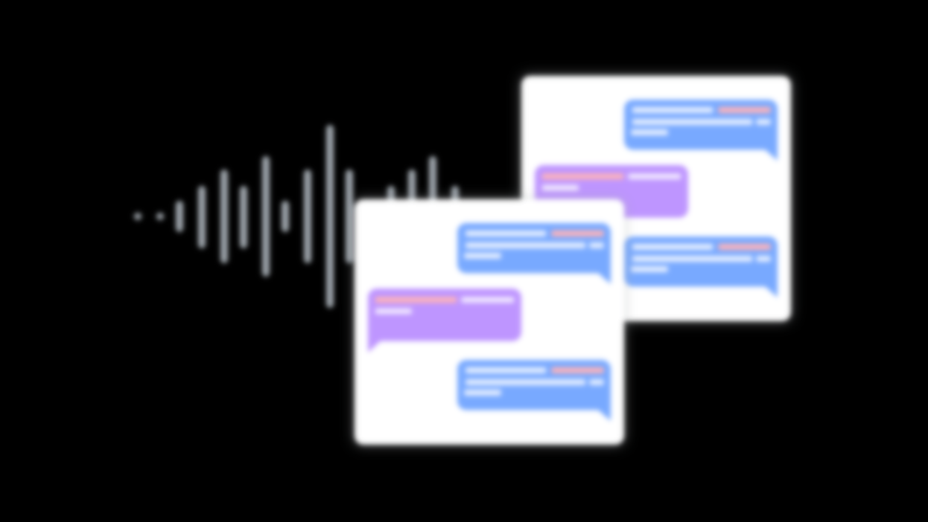

A significant percentage of business start-ups fail due to some weaknesses in their elevator pitch.
IBM Watson uses speech-to-text conversion, then classifies the emotion feature from the generated text directly.
Our approach differs by the fact that the designed model, identifies the speech emotions and language fluency through direct voice analysis.
After a wide research about machine learning use to classify audios, we found unsatisfying accuracies, and biased model cases.
The thing we took into consideration, while gathering and training on more data, designing an immune architecture, and tuning parameters to seek a significant accuracy score.
Have others solved it?
Notes:
How have others solved the problem?
describe them briefly and explain what you will do differently

Slide 7
A significant percentage of business start-ups fail due to some weaknesses in their elevator pitch.
Fluency model preparation:
Cloning dataset from: Avalinguo-Audio-Set
Using Librosa library to extract 23 audio features: MFCCs, RMSE, Spectral flux, Zero Crossing Rate
Rewriting the audio data samples in a suitable .wav format
Labeling the data samples based on their father directory
Classes are:Low Fluency: 438 Intermediate: 527 High Fluency: 459
Method description with technical details of your model and data preprocessing pipeline.
Notes:
Method description with technical details of your model and data preprocessing pipeline.
Mention any important decisions/restrictions your method has.

Slide 8
A significant percentage of business start-ups fail due to some weaknesses in their elevator pitch.
Emotions model preparation:
Gathering 4 datasets from kaggle.com and GitHub.com : SAVEE - RAVDES - TESS - CREMA-D
Renaming and unifying the classes for all datasets samples
Using Librosa library to extract 23 audio features: MFCCs, RMSE, Spectral flux, Zero Crossing Rate, Spectral Bandwidth, Spectral Centroid..
Classes are: Angry: 1923 Fear: 1923 Disgust: 1923 Happy: 1923 Sad: 1923 Neutral: 1935 Surprize:652
Method description with technical details of your model and data preprocessing pipeline.
Notes:
Method description with technical details of your model and data preprocessing pipeline.
Mention any important decisions/restrictions your method has.

Slide 9
A significant percentage of business start-ups fail due to some weaknesses in their elevator pitch.
Fluency model preparation:
One hot encoding the labels of the samples
Using train_test_split to divide data between testing(30%) and training(70%)
Creating a traditional neural network sequential model with 7 dense layers
After fitting the model on our training data, with a batch size of 16, sgd optimizer, and 100 epochs, we reached a training accuracy of 60% and validation accuracy of 52%.
Different Conducted Experiments
Notes:
Describe the different experiments you ran include data description, data splits, experiments conducted

Slide 10
A significant percentage of business start-ups fail due to some weaknesses in their elevator pitch.
Fluency model preparation:
Since the accuracy score was not satisfying, we redesigned the model by creating a sequential model with 7 layers (conv1D, pooling, dropouts, dense)
After fitting the model on our training data, with a batch size of 32, rmsprop optimizer, and 100 epochs, we reached a training accuracy of 98% and validation accuracy of 91%.
Different Conducted Experiments
Notes:
Describe the different experiments you ran include data description, data splits, experiments conducted

Slide 11
A significant percentage of business start-ups fail due to some weaknesses in their elevator pitch.
Emotions model preparation:
One hot encoding the labels of the samples
Using train_test_split to divide data between testing(25%) and training(75%)
Trying the same model used for the language fluency feature here, and editing its output layer for sure.
After fitting the model on our training data, with a batch size of 16, Adam optimizer, and 100 epochs, we reached a training accuracy of 55% and validation accuracy of 45%.
Different Conducted Experiments
Notes:
Describe the different experiments you ran include data description, data splits, experiments conducted

Slide 12
A significant percentage of business start-ups fail due to some weaknesses in their elevator pitch.
Emotions model preparation:
Since the use of the model, over different data distributions did not lead to accepted results, we tried to improve our application on 3 levels: Data, model architecture and hyper parameters tuning.
In addition to the 4 datasets, we increased the training set with the OpenSLR dataset, and to treat the occurring unbalance of classes ( relatively lower amount of audios labeled “Surprised”, we used Librosa library to generate new “surprised” samples having some noise, pitch and shift effects.
On the model design level, we used a more complicated sequential model with about 14 layers (conv1D, pooling, dropouts, batch normalization, dense)
After fitting the model on our updated training data, with a batch size of 16, Adam optimizer, and 100 epochs, we reached a training accuracy of 74% and validation accuracy of 73%.
Different Conducted Experiments
Notes:
Describe the different experiments you ran include data description, data splits, experiments conducted

Slide 13
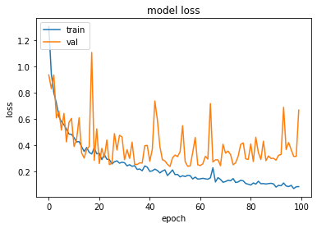
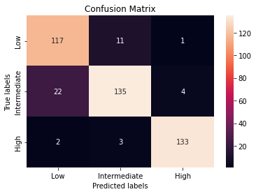
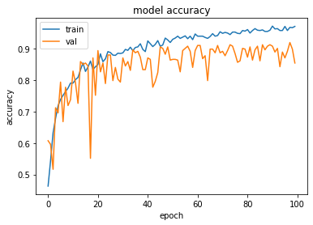
Fluency Model
Metrics
Notes:
Show evaluation includes numerical results (metrics and comparisons),qualitative results(if applicable, such as visually inspecting outputs) and analysis from the results (eg. what worked and what did not work for your method)

Slide 14
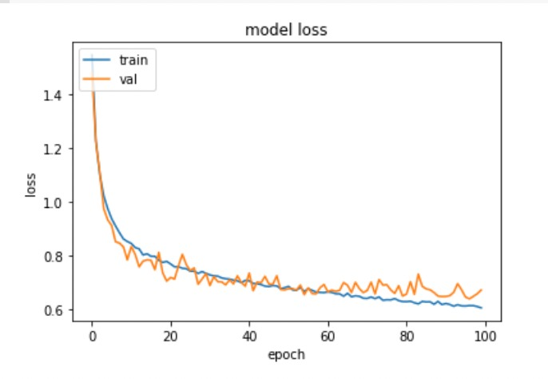
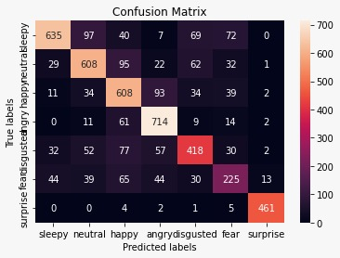
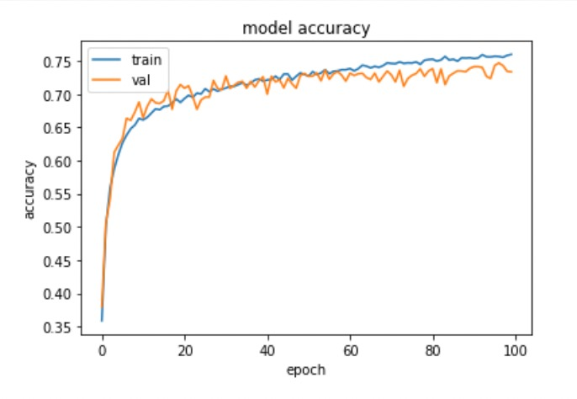
Emotions Model
Metrics
Notes:
Show evaluation includes numerical results (metrics and comparisons),qualitative results(if applicable, such as visually inspecting outputs) and analysis from the results (eg. what worked and what did not work for your method)

Slide 15
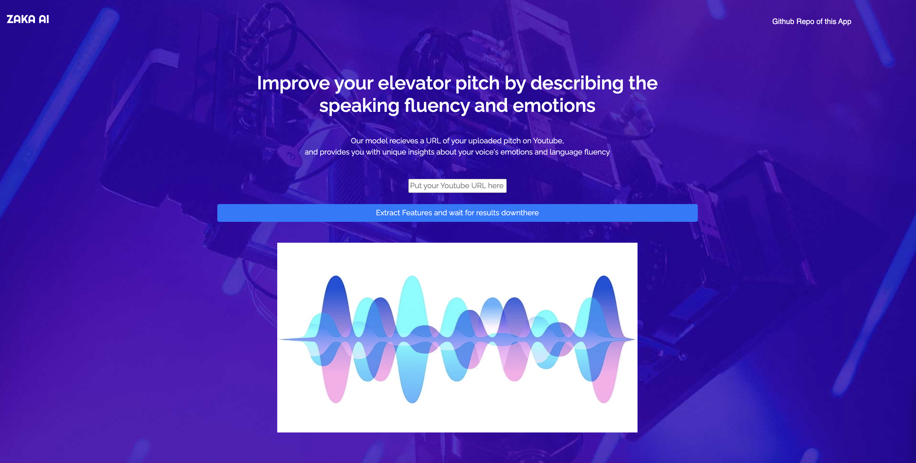
12
Caption
Notes:
Demo of results or model in action. This should not be a live demo! you can include screenshots of output predictions from the model or recorded videos.

Slide 16
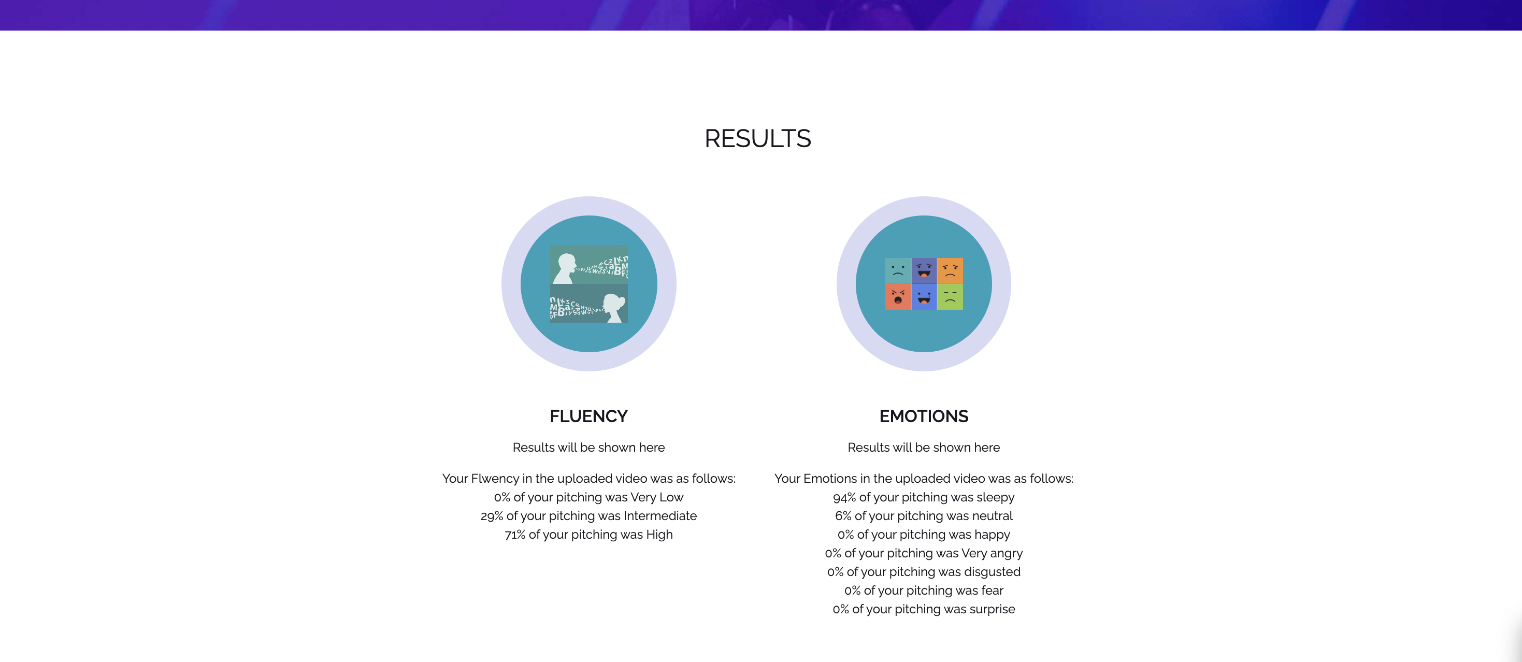
12
Caption
Notes:
Demo of results or model in action. This should not be a live demo! you can include screenshots of output predictions from the model or recorded videos.

Slide 17

The created models showed satisfying scores, and could be reliable as a speech scoring tool.
Based on the using purpose, we can map the output scores and percentages, to case-based classifications, ex: considering “happy” and “surprised” as “Excited about his start-Up”, or “neutral” and “sleepy” as “unconfident about his solution’s potential”, and so on..
Also, the fluency score, can describe how smoothly the founder’s ideas are delivered to the ears of the potential investors.
Futures steps that can upscale our application, are adding more features either computed or model predicted, like the word-level pronunciation, filler words detecting, same word repetition, tonality levels..etc
Conclusion
Notes:
Conclusion and future work/ directions that can be taken to improve. This should be brief!

